Slide 1
DOE Laboratory Accreditation Program
2023 DOELAP External Dosimetry Assessor Training Idaho Falls, ID
David L. Pugh, CHP, RRPT
Office of Worker Safety and Health Policy (EHSS-11) Office of Environment, Health, Safety and Security
U.S. Department of Energy

Slide 2
DOELAP Administrator - Introduction
Background
Air Force active duty (1997-2017)
Analytical Services - Wright-Patterson AFB, Ohio (2017-2023)
Technical Director, Air Force Dosimetry
NVLAP accredited for passive and active dosimetry
Transitioned from Panasonic to Landauer OSL in 2020 (in-house program)
Lab Manager/Supervisor-Radiation Services
External Dosimetry
Radioanalytical Lab
Joined EHSS-11 team in April 2023
10 CFR 835/DOELAP Administration/Outreach

Slide 3
Opening Remarks
DOELAP established in 1986 to ensure monitoring across the complex is:
Consistent,
Accurate, and
Conforms to accepted standards.
DOELAP’s continued success as the gold standard for accreditation is a team effort:
Office of Environment, Health, Safety, and Security,
Radiological and Environmental Sciences Laboratory,
Oversight Board,
Assessors,
DOE Site Office Managers,
Dosimetry Programs across the complex.

Slide 4
Opening Remarks – My Responsibilities
To each of you:
Deliver well thought out policy and guidance,
Provide value added contributions to RESL and the Oversight Board,
Serve as your headquarters advocate for external dosimetry and radio-bioassay programs,
Listen to your concerns and challenges.
For the Department:
Ensure DOELAP anticipates, adjusts and is responsive to:
Technological improvements,
Trends within the industry,
Revisions to national/international standards.
Interface with Program Office and Site Office Health Physicists.

Slide 5
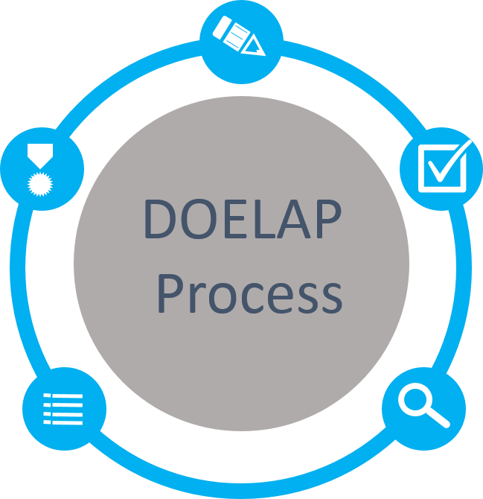
DOE Laboratory Accreditation Program (DOELAP)
Application
Quality Assurance Program
Field Office Review
Performance Testing
ANSI N13.11, Personnel Dosimetry Performance Criteria and Testing
ANSI N13.32, Performance Testing for Extremity Dosimeters
ANSI N13.30, Performance Criteria for Radiobioassay
Accreditation
Period of 3 years
Notify DOELAP of changes
Oversight Board Review
Complete Package
Recommendations to Administrator
On-Site Assessment
Direct observation and evaluation
Conducted by technical experts

Slide 6
Oversight Board
Current Membership
Michael Souleyrette
Govind Rao
Milan Gadd
Kelly Crandall
Lydia Tai
Cheryl Antonio
Nathan Elliot
New Appointments (2023)
Ken Veinot (Y-12)
Richard Pierson (PNNL)
Adam Stavola (TJNAF)

Slide 7
Oversight Board
Certificate of Appreciation – 5 Year Term
Michael Souleyrette
Govind Rao
Milan Gadd
Kelly Crandall
Lydia Tai
Cheryl Antonio

Slide 8
Professional Conduct
Professionalism, dedication, and ethical principles must be placed above private gain.
Must abstain from financial, employment, private or any other interests that conflict from conscientious performance of duty.
Ensure non-public DOELAP information must not be disclosed or used to further any private interest.
Must not solicit or accept gifts from any activity whose interests may be substantially impacted
Must not make any unauthorized commitments of DOELAP
Must act impartially and not give preferential treatment
Avoid any actions creating the appearance of violation of ethical standards
1
2
3
4
5
5
7

